Slide 1
Disaggregating Diabetes & Hypertension Risk
Rithvik Harinath
Notes:
Hey everyone, my name is Rithvik Harinath and today I'll be presenting my deaggregation of diabetes and hypertension risk.

Slide 2
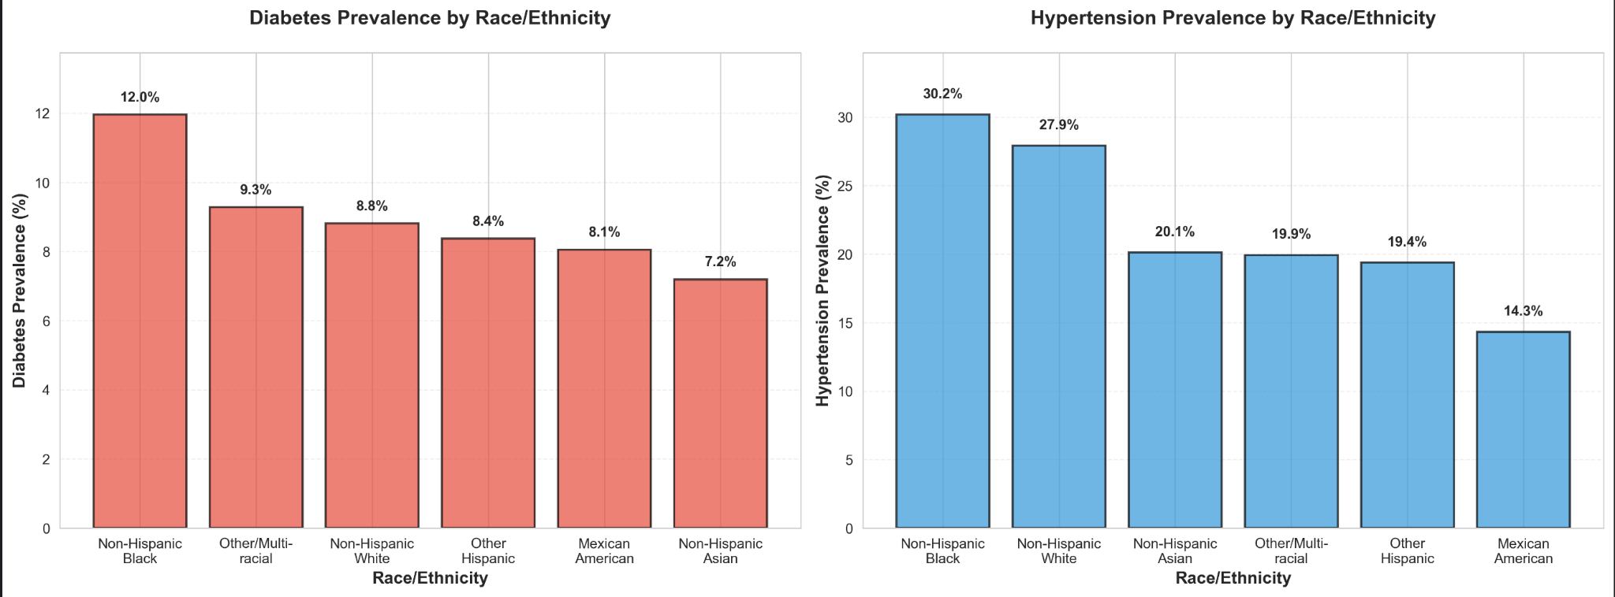
Hypertension & Diabetes Prevalence Vary
Current prevention guidelines are generic (DASH diet, 150 mins weekly activity)
But diabetes & hypertension prevalence varies across racial groups
Hypertension: 30.2% in Non-Hispanic Blacks vs. 14.3% in Mexican Americans
Diabetes: Ranges from ~7% to >12% across groups.
Does the same advice work for everyone? For example, if a patient’s most significant risk factor is poverty, how much does prescribing more exercise truly help them?
Notes:
So current diabetes and hypertension prevention guidelines often follow a one-size-fits all approach, generally giving more generalized advice like "spend 150 " But diabetes and hypertension prevalence varies amongst various races, which suggests that the biggest risk factors for these diseases may actually vary across groups. Sometimes it may not be optimal to prescibe exercise as a main treatment, for example, if the highest risk factor for that racial group is actually caloric intake.

Slide 3
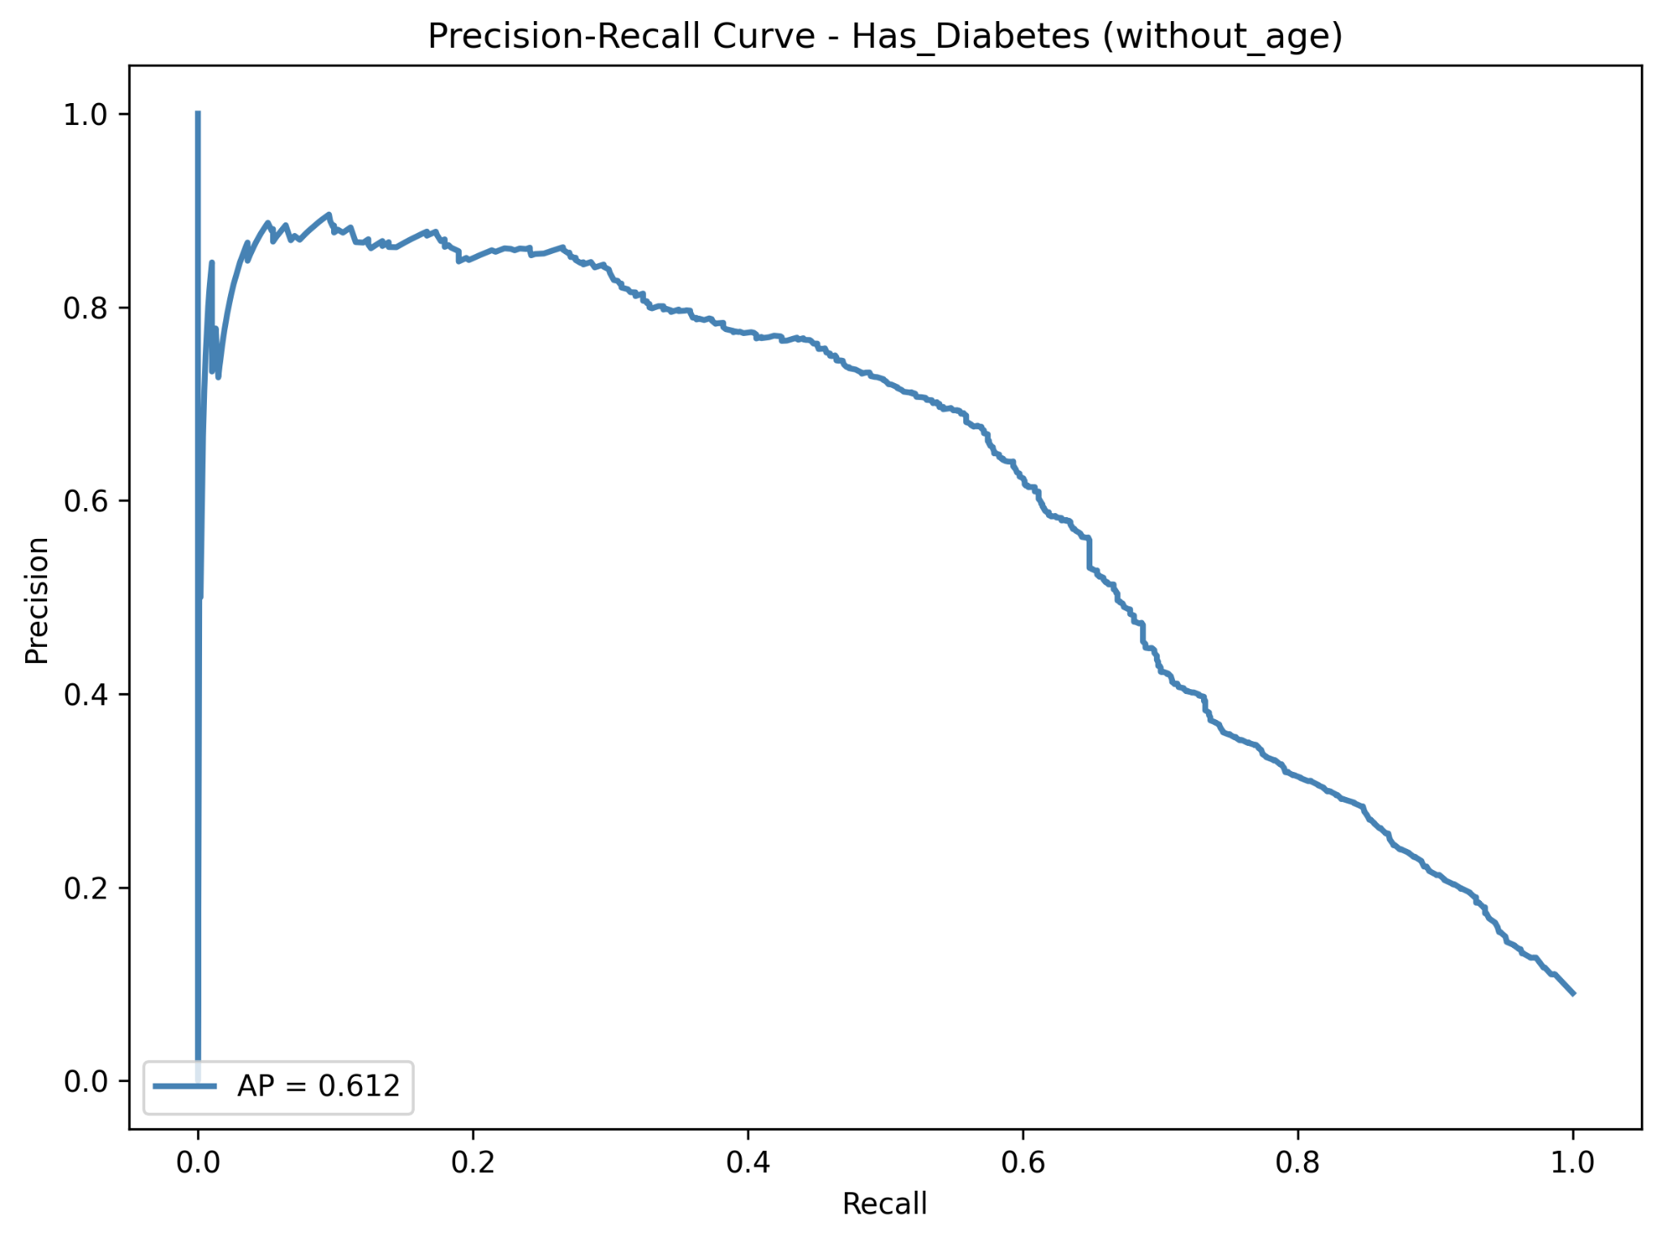
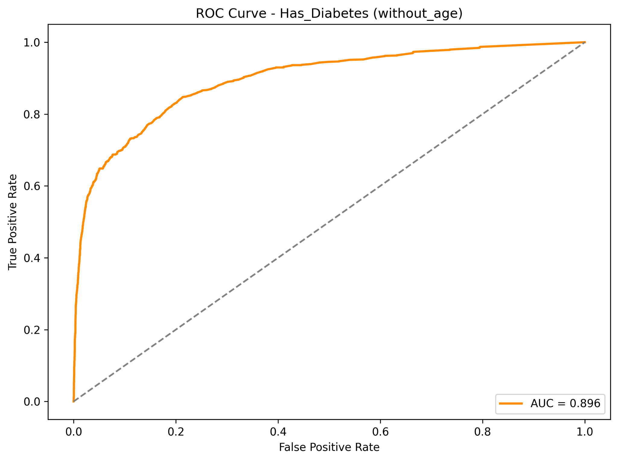
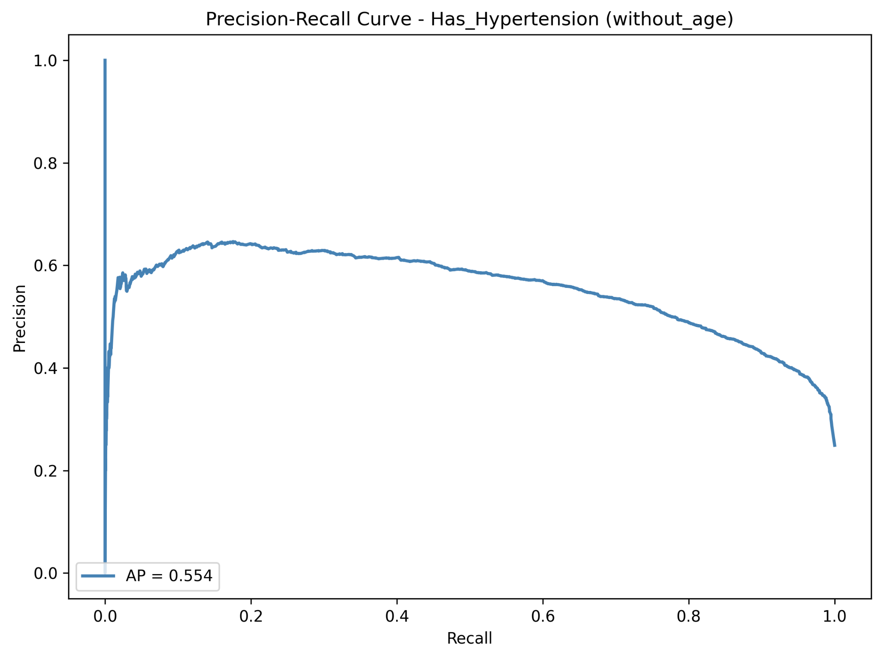
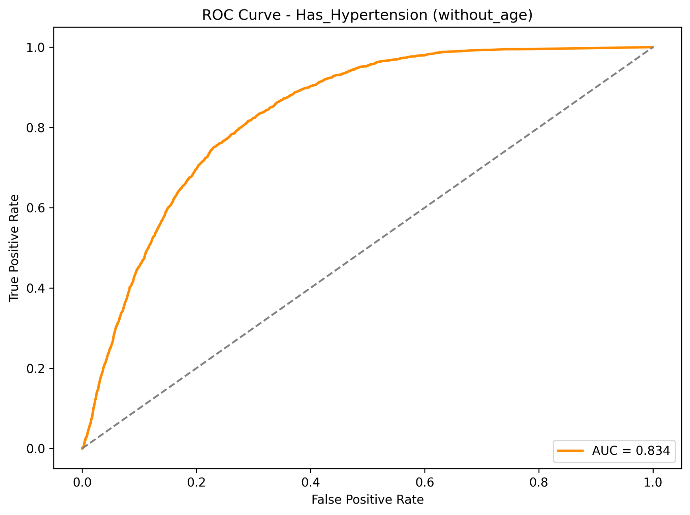
Methodology
Used NHANES Dataset (n=11,933): Nationally Representative sample
Goal: Look at most important diabetes & hypertension predictors
Permutation Importance
Model: Random Forest (high stability, good PR-AUC, strong ROC-AUC scores)
24 features used
Diabetes
Hypertension
PR-AUC = 0.612
ROC-AUC = 0.896
PR-AUC = 0.554
ROC-AUC = 0.834
Notes:
For this project, I used the NHANES dataset, which is a survey that participants across the U.S. filled out regarding their current health status. The goal is to stratify by race and look at what the most important predictors of diabetes and hypertension are for each racial group based on permutation feature importance. I used Random Forest because it has high feature stability compared to the other models I tested, and has relatively strong PR and ROC scores as you can see below.

Slide 4
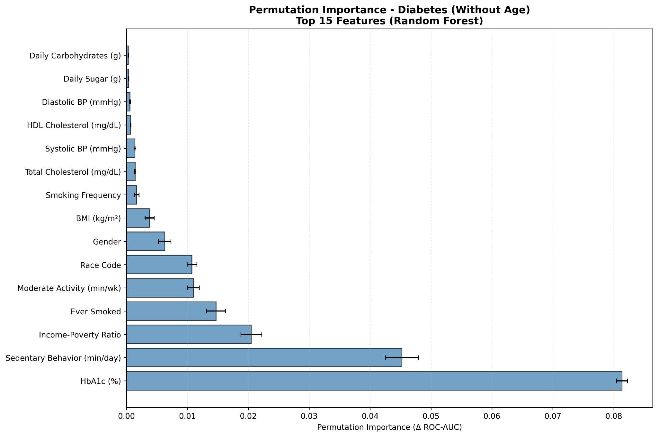
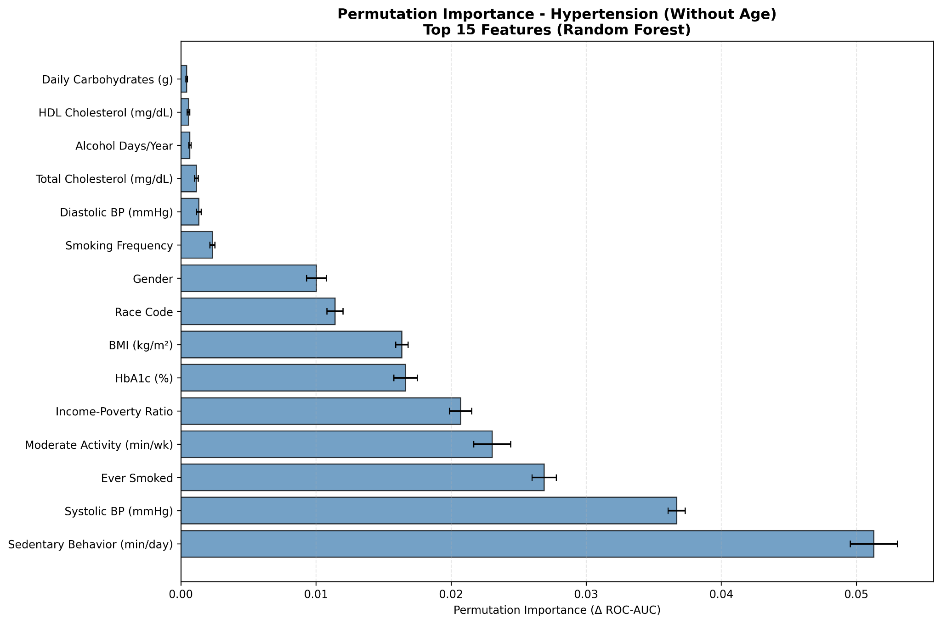
Universal Risk Factors
Biological Constants
Blood Glucose: #1 universal diabetes risk factor
Systolic BP: #2 universal hypertension risk factor
Behavioral Insights
Sedentary Behavior: #1 risk factor for hypertension
“Sitting Less” overall is stronger advice than “exercising more”
To prevent these diseases, we should encourage on a consistently active lifestyle and sitting less rather than simply relying on scheduled exercise.
Notes:
First of all, we discovered various universal risk factors. Blood glucose and systlolic blood pressure are the top risk factors for diabetes and hypertension respectively, which make sense since we know they directly cause these disorders. But we also revealed some behavioral insights, mainly that sedentary behavior was the #1 behavioral risk factor for hypertension. Sitting less is overall stronger advice than exercising more based on the data, and to prevent such diseases, we should enroucrage patients to consistently stand up and move around in their lives more, by means such as standing desks.

Slide 5
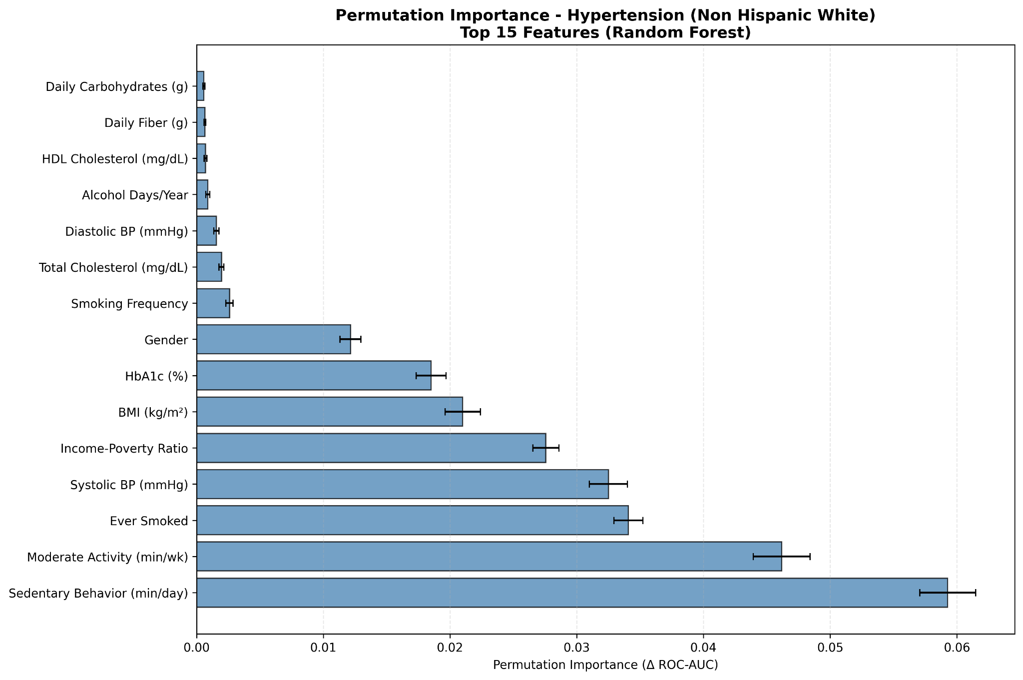
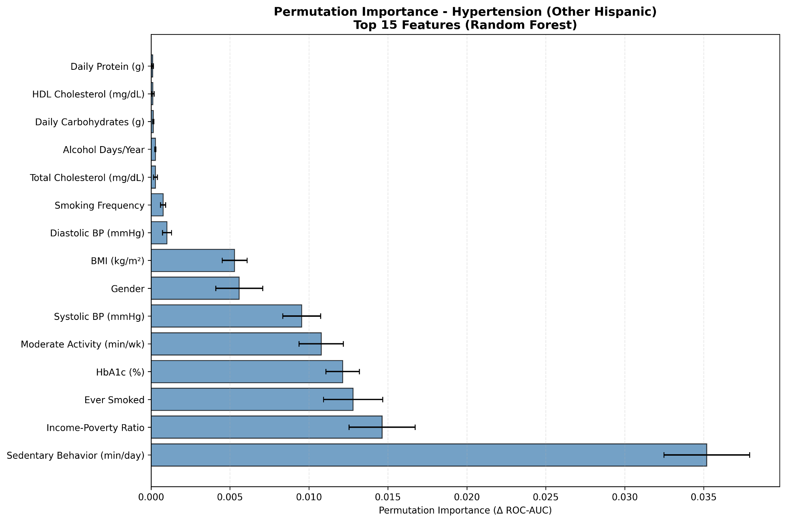
Population-Specific Risk Factors
Non-Hispanic White & Non-Mexican Hispanic (Hypertension):
Lifestyle choices (Sedentary Behavior + Smoking) dominate permutation importance scores
For these groups, smoking prevention programs/campaigns are important in hypertension prevention for these groups
Notes:
There were also several population-specific risk factors we came across. Firstly, non-hispanic whites and non-mexican hispanics had lifestyle factors dominate their feature importance, including if they had smoked. This shows that anti smoking programs should be held for these groups to prevent hypertension.

Slide 6
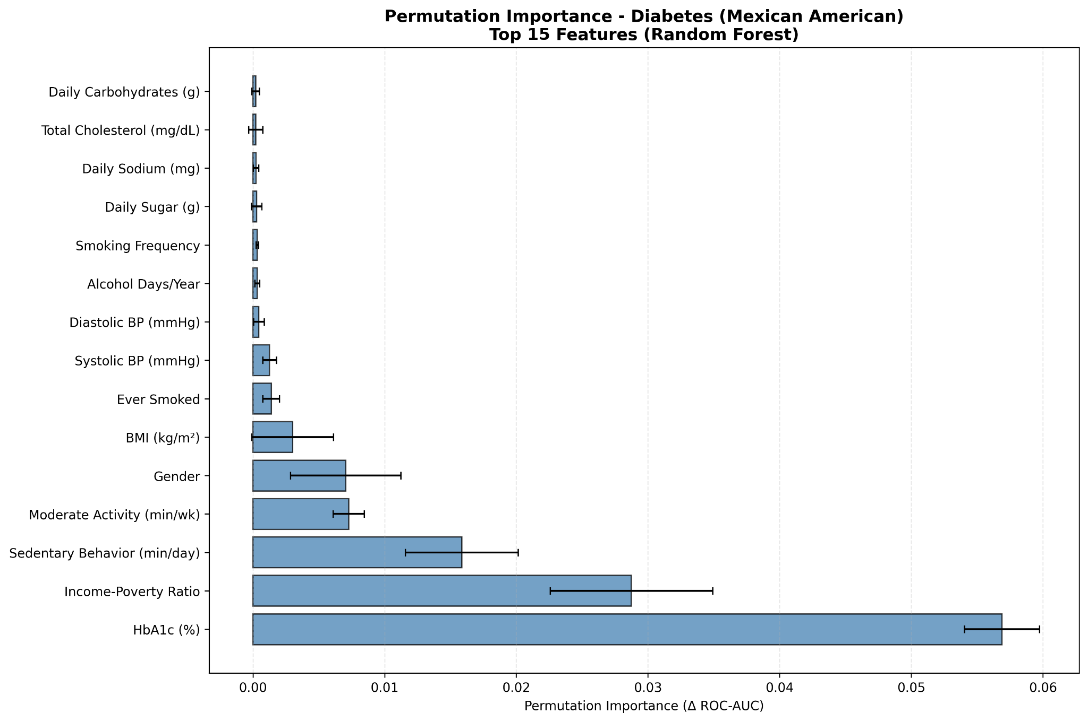
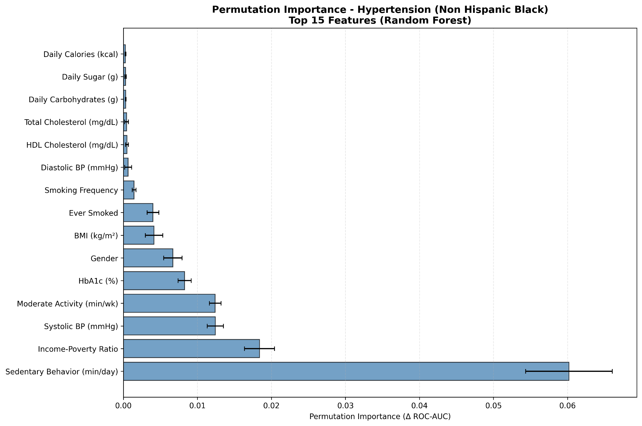
Population-Specific Risk Factors
Mexican American & African-American:
Poverty Ratio is an important driver for historically marginalized groups
Economic support (food assistance, housing stability, etc) can play an especially important part in reducing diabetes & hypertension risk, as it is often a stronger medical intervention than other factors like weight loss
Notes:
Another factor we found is that for both diabetes and hypertension, poverty rate was in the top 3 features for mexican americans and african americans. this shows that for marginalized groups like these, systemic issues are just as important issues as typical diabetes risk factors, and should be addressed since such issues serve as a barrier for members of these groups to get the help they need. economic suport like food assistance, housing stability, and so on can greatly help reduce rates for these groups.

Slide 7
Thank You!

